Slide 1


Slide 2
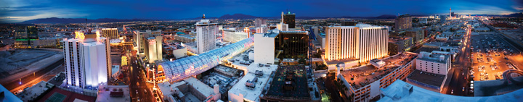
City of Las Vegas
Redevelopment Agency
Quarterly Update – Strategy Focus
FY2010, 3rd Quarter
March 17, 2010

Slide 3

Presentation Today
Review Strategic Business Plan for OBD
Update on Progress During 3rd Quarter FY10
Strategic Results
Effectiveness of RDA: Comparison to San Diego CCDC’s Past Efforts
Preview of New Strategies at OBD

Slide 4
OBD Strategic Business Plan
Department Mission:
To provide business attraction, retention, urban and economic development services to businesses, developers and investors so they can operate profitably, which contributes to a sustainable, diverse economy.

Slide 5
Strategic Business Plan – Lines of Business
Redevelopment Line of Business
  Development Negotiations: attract new development and new investment through public-private partnership agreements.
  Development Management: acquire and manage real property for redevelopment and economic development.
Business Development Line of Business
  Business Attraction and Expansion: work with existing businesses and new businesses to locate or expand in Las Vegas.

Slide 6
Update: Development Negotiations
CIM Lady Luck Re-use
Cordish – Arena & Live District
Symphony Park
  Cleveland Clinic Master Plan
  Medical User for Parcel L
  Smith Center Campus – Phase 2 Development
Solterra Residential at Fourth & Clark
Re-use Strategy for Cashman Center

Slide 7
Update: Development Management
Currently Managing Portfolio of 147 Acres
  Roughly 100 acres are under contract
  Assets include 4 parking garages
RFP to Evaluate Parking Ownership & Management
  Exploring public-private partnership opportunities to maximize yield of parking assets
Symphony Park Land Development
  Overseeing infrastructure installation, development planning and financial management with Newland

Slide 8
Update: Business Attraction & Expansion
Sale/re-use of 2400 Tenaya – Ground Lease
Retail Bank Branch at Enterprise Park
601 Fremont – Mixed-use Development with Entertainment Component
Las Vegas Business Incubator
New Web Site & Social Media Marketing
Working with Business Constituencies and Advocacy Groups, Including Diversity Outreach

Slide 9
Strategic Business Plan - Results
Strategic Results
  Economic Diversification
  Maintain Land Inventory for Economic Development & Redevelopment
  Growth of RDA Tax Base
  Development Permit Activity (RDA Emphasis)
  Effectiveness of Incentives (Public-Private Ratio)
In Short, Expanding the Job Base & Tax Base

Slide 10
Strategic Business Plan - Results
Strategic Results
  Economic Diversification
  Maintain Land Inventory for Economic Development & Redevelopment
  Growth of RDA Tax Base
  Development Permit Activity (RDA Emphasis)
  Effectiveness of Incentives (Public-Private Ratio)
In Short, Expanding the Job Base & Tax Base

Slide 11
Economic Diversification: Symphony Park
ECONOMIC IMPACT, FTEs
Total Jobs Impact Clark County City of Las Vegas Project Construction 3,783 1,330 Project Operations 14,110 10,023
AVERAGE ANNUAL SPENDING
Project Construction $4.1 billion $1.4 billion
Project Operations $1.8 billion $1.6 billion
ANNUAL TAX REVENUE TO CITY OF LAS VEGAS
$20.875 million
Estimates from Restrepo Consulting Group, Economic & Fiscal Benefits Study, August 2009

Slide 12
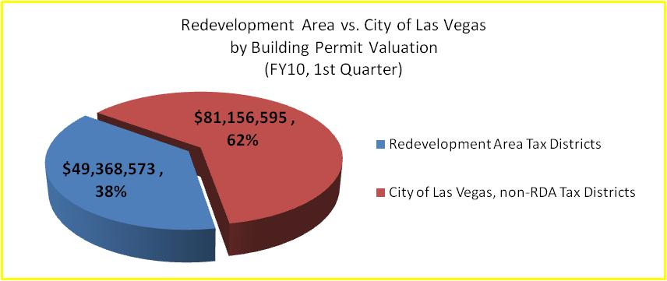
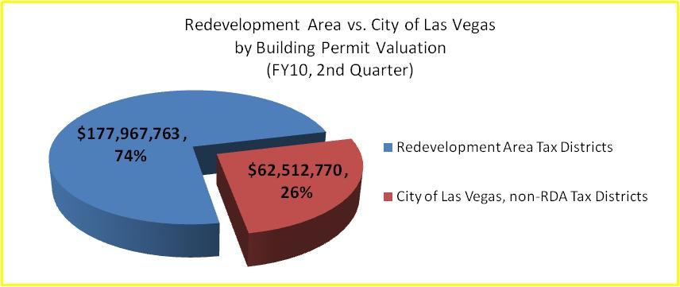
Development Permit Activity

Slide 13
Effectiveness of Incentives
Between inception of the RDA & December 2008, $16 of private investment occurred for every $1 of public investment
Compares favorably to other Redevelopment Agencies
Case Study – San Diego CCDC
  Formed in 1975 as nonprofit arm for redevelopment
  Project areas of Centre City (Marina, Columbia & Gaslamp Quarter) and Horton Plaza

Slide 14
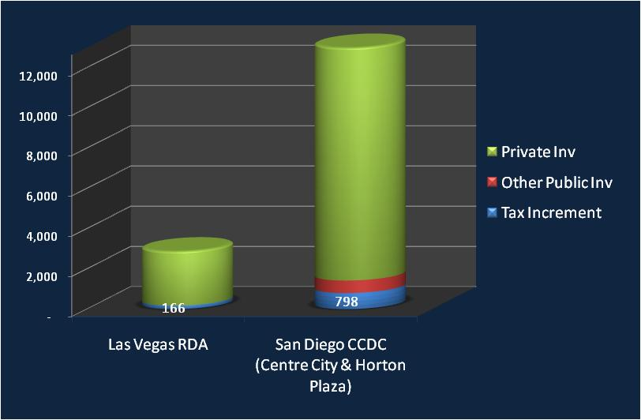
TIF Comparison: RDA to CCDC
Millions
Private-to-Public: 9:1
Private-to-Public: 16:1

Slide 15
Jobs Comparison: CCDC to Las Vegas RDA
 | San Diego CCDC* | Las Vegas RDA
Permanent Jobs | 26,000 | 9,414
RDA Tax Increment (millions) | 798.2 | 166
RDA Investment Period | 34 years | 22 years
*Source: http://media.ccdc.com/resources/resource_files/ccdc/CCDC_Economic_Gain.pdf

Slide 16
Preview of Future Strategies
Working with City Manager’s Office & City Council on New Strategies and Implementation:
  Economic Diversification
  Citizens Advisory Committee
  Employment Plan Policy
  Redevelopment Area Expansion
Limitations due to
  Allowable expenses using Redevelopment Agency tax increment revenues
  Projected revenue decline

Slide 17
Impacts of Projected Revenue Decline
FY10 T.I. revenue in line with projections
  $21.98M through March 15
  $27.9M projected through year-end
FY11 revenue projected at $25.2M, or a 11% decline year-over-year
Doing more with less – 22 FTEs in OBD versus peak of 26 FTEs (15% reduction)
Limited capital investment in new projects

Slide 18
City of Las Vegas
Redevelopment Agency
Quarterly Update – Strategy Focus
FY2010, 3rd Quarter
March 17, 2010

